Slide 1
Test In Production
Pravin Y Pawar
Adapted from “Designing Machine Learning Systems”
By Chip Huyen

Slide 2
Offline Evaluation
An offline model evaluation happens when the model is being trained by the analyst
The analyst tries out different
features,
models,
algorithms,
and hyperparameters
Model training is guided in the right direction by
Tools like confusion matrix
Various performance metrics, such as precision, recall, and AUC
Process
First, validation data is used to assess the chosen performance metric and compare models
Once the best model is identified, the test set is used, also in offline mode, to again assess the best model’s performance
This final offline assessment guarantees post-deployment model performance

Slide 3
Offline Evaluation(2)
Two major test types for offline evaluation
Test splits
are usually static and have to be static so that you have a trusted benchmark to compare multiple models
will be hard to compare the test results of two models if they are tested on different test sets
Backtests
method of testing a predictive model on data from a specific period of time in the past
If model is updated to adapt to a new data distribution, it’s not sufficient to evaluate this new model on test splits from the old distribution
one idea is to test model on the most recent data that you have access to - after updated model on the data from the last day, might want to test this model on the data from the last hour
The question is whether backtests are sufficient to replace static test splits. Not quite!
If something went wrong with data pipeline and some data from the last hour is corrupted, evaluating model solely on this recent data isn’t sufficient.
With backtests, should still evaluate model on a static test set that have been extensively studied and (mostly) trust as a form of sanity check.

Slide 4
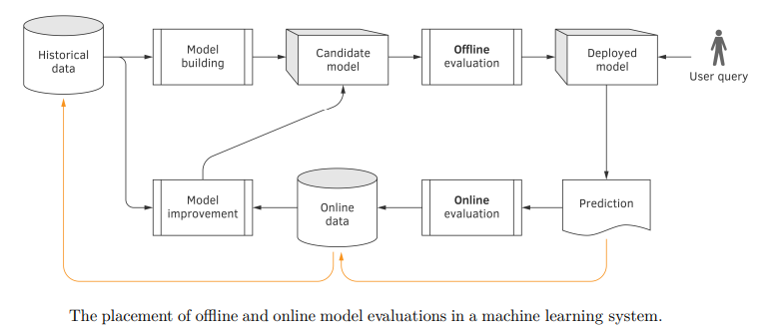
Offline and Online Evaluation
Historical data is first used to train a deployment candidate
Then it is evaluated offline
If the result is satisfactory, deployment candidate becomes the deployed model, and starts accepting user queries
User queries and the model predictions are used for an online evaluation of the model
The online data is then used to improve the model
To close the loop, the online data is permanently copied to the offline data repository
Source: Machine Learning Engineering by Burkov

Slide 5
Why do we evaluate both offline and online?
The offline model evaluation reflects how well the analyst succeeded
in finding the right features, learning algorithm, model, and values of hyperparameters
reflects how good the model is from an engineering standpoint
Online evaluation, focuses on measuring business outcomes,
such as customer satisfaction, average online time, open rate, and click-through rate
may not be reflected in historical data, but it’s what the business really cares about
Offline evaluation doesn’t allow us to test the model in some conditions that can be observed online,
such as connection and data loss, and call delays

Slide 6
Test in production
Aka Online Evaluation
The only way to know whether a model will do well in production is to deploy it
led to one seemingly terrifying but necessary concept
Techniques to help to evaluate models in production (mostly) safely
Shadow deployment
A/B testing
Canary analysis
Interleaving experiments
Bandits
To sufficiently evaluate models, first need a mixture of offline evaluation and online evaluation!

Slide 7
Shadow Deployment
Might be the safest way to deploy model or any software update
Works as follows
1. Deploy the candidate model in parallel with the existing model
2. For each incoming request, route it to both models to make predictions,
but only serve the existing model’s prediction to the user
3. Log the predictions from the new model for analysis purposes.
Only when found that the new model’s predictions are satisfactory do replace the existing model with the new model!
The risk of this new model doing something funky is low
as don’t serve the new model’s predictions to users until made sure that the model’s predictions are satisfactory
Always not favorable because it’s expensive
doubles the number of predictions system has to generate, which generally means doubling inference compute cost

Slide 8
A/B Testing
A way to compare two variants of an object, typically by testing responses to these two variants, determining which of the two variants is more effective
the existing model as one variant, and the candidate model (the recently updated model) as another variant
Works as follows:
Deploy the candidate model alongside the existing model
A percentage of traffic is routed to the new model for predictions; the rest is routed to the existing model for predictions.
Monitor and analyze the predictions and user feedback, if any, from both models to determine whether the difference in the
two models’ performance is statistically significant.
Two important things:
First, A/B testing consists of a randomized experiment: the traffic routed to each model has to be truly random.
If not, the test result will be invalid
Second, A/B test should be run on a sufficient number of samples to gain enough confidence about the outcome.
How to calculate the number of samples needed for an A/B test is a simple question with a very complicated answer.
Often, in production, you don’t have just one candidate but multiple candidate models
possible to do A/B testing with more than two variants, which means can have A/B/C testing or even A/B/C/D testing

Slide 9
Canary Release
A technique to reduce the risk of introducing a new software version in production by slowly rolling out the change to a small subset of users
before rolling it out to the entire infrastructure and making it available to everybody
Works as follows:
Deploy the candidate model alongside the existing model. The candidate model is called the canary
A portion of the traffic is routed to the candidate model.
If its performance is satisfactory, increase the traffic to the candidate model.
If not, abort the canary and route all the traffic back to the existing model.
Stop when either the canary serves all the traffic (the candidate model has replaced the existing model) or when the canary is aborted
The candidate model’s performance is measured against the existing model’s performance according to the metrics you care about
If the candidate model’s key metrics degrade significantly, the canary is aborted and all the traffic will be routed to the existing model
Canary releases can be used to implement A/B testing due to the similarities in their setups
don’t have to randomize the traffic to route to each model
first roll out the candidate model to a less critical market before rolling out to everybody

Slide 10
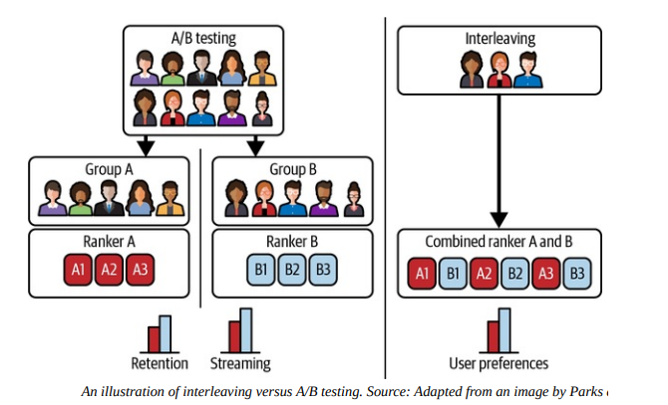
Interleaving Experiments
Imagine two recommender systems, A and B, and want to evaluate which one is better
Each time, a model recommends 10 items users might like
With A/B testing, divide users into two groups: one group is exposed to A and the other group is exposed to B.
Each user will be exposed to the recommendations made by one model
What if instead of exposing a user to recommendations from a model, we expose that user to recommendations from both models and see which model’s recommendations they will click on?

Slide 11
Interleaving Experiments(2)
In A/B testing, core metrics like retention and streaming are measured and compared between two groups
In interleaving, two algorithms can be compared by measuring user preferences,
no guarantee that user preference will lead to better core metrics
Netflix found that interleaving “reliably identifies the best algorithms with considerably smaller sample size compared to traditional A/B testing.”
When recommendations from multiple models are shown to users,
the position of a recommendation influences how likely a user will click on it
users are much more likely to click on the top recommendation than the bottom recommendation
For interleaving to yield valid results, must ensure that at any given position,
a recommendation is equally likely to be generated by A or B.

Slide 12
Bandits
Bandit algorithms originated in gambling!
A slot machine is also known as a one-armed bandit
A casino has multiple slot machines with different payouts
don’t know which slot machine gives the highest payout
Can experiment over time to find out which slot machine is the best while maximizing payout
Multi-armed bandits are algorithms
allow you to balance between
exploitation (choosing the slot machine that has paid the most in the past)
and exploration (choosing other slot machines that may pay off even more)
When multiple models needs to be evaluated, each model can be considered a slot machine whose payout (i.e., prediction accuracy) is unknown
Bandits allow to determine how to route traffic to each model for prediction to determine the best model while maximizing prediction accuracy for users

Slide 13
Bandits(2)
Bandit is stateful: before routing a request to a model, need to calculate all models’ current performance
Requires three things:
Model must be able to make online predictions
Preferably short feedback loops
A mechanism to collect feedback, calculate and keep track of each model’s performance, and route prediction requests to different models based on their current performance
Bandits are well-studied in academia and have been shown to be a lot more data efficient than A/B testing
require less data to determine which model is the best
at the same time, reduce opportunity cost as they route traffic to the better model more quickly
But a lot more difficult to implement than A/B testing because it requires computing and keeping track of models’ payoffs

Slide 14
Thank You!
In our next session:

